Slide 1
The Postnatal Period
Caring for a newborn

Slide 2
The Postnatal Period
Post Natal
  Time after birth

Slide 3
The Newborn at Birth
Baby takes first breath
Umbilical cord is clamped, tied, and cut off

Slide 4
The Newborn at Birth
Head= lopsided or pointed
  Fontanels
Face= swollen or puffy, flat nose, and a receding chin
Eyes= dark grayish blue
  Permanent eye color appears within several months

Slide 5
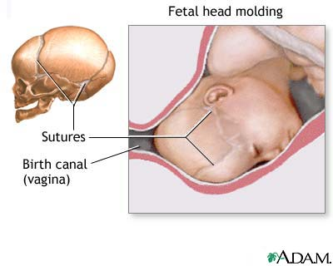
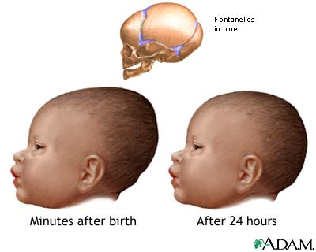

Slide 6
Examining the Newborn
Apgar scale
  Rating of 0-2 on 5 areas:
        Heart Rate
        Breathing
        Muscle Tone
        Reflex to Stimulation
        Skin Color
  Total score of 6-10 is considered normal
Notes:
Done 1 minute after birth and 5 minutes after birth
Anything lower than a 6 could mean the baby needs special medical attention
The baby is weighed, measured, and cleaned up
Baby is identified by foot print for public records and name bands are placed on wrists

Slide 7
Apgar Scale
 | 0 | 1 | 2
Heart Rate | Absent | Under 100 | Over 100
Breathing | Absent | Slow, irregular | Good, crying
Muscle Tone | Limp | Some movement of extremities | Active motion
Responsiveness | No response | Grimace | Cough or sneeze
Color | Light-skinned child: Blue or pale Dark-skinned child: Grayish or pale | Light-skinned child: Body pink, limbs blue Dark-skinned child: Strong body color, grayish limbs | Light-skinned child: Completely pink Dark-skinned child: Strong color with pink lips, palms, and soles

Slide 8
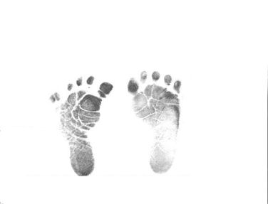
Examining the Newborn
Weight & Measurements
Footprints
Name band

Slide 9
Later Tests
Antiseptic
Vitamin K shot
Blood Sample
Notes:
Antispetic is put in baby’s eyes within 60 minutes after birth to prevent infection
Vitamin K prevents blood clot- baby’s are low in vitamin K, therefore given a shot
Blood sample tests for any conditions such as PKU and sickle cell anemia

Slide 10
Bonding and Attachment
Importance of Bonding
  Forming strong emotional ties between parent and child
Notes:
Most delay cutting the umbilical cord, cleaning the infant, and giving the eye drops to allow the parents and child to begin bonding right away
Mother may begin nursing right away if they are going to breast-feed

Slide 11
Bonding Article
Read through “Bonding With Your Baby” Article
Answer questions

Slide 12
The Hospital Stay
Mother and baby may go home as soon as 12 hours after birth
Average is 2-3 days after birth

Slide 13
Help with Feeding
Lactation Consultants
  Professional breast-feeding specialists
Nurses

Slide 14
Rooming-In
Many hospitals offer the option of full or partial rooming-in
  Full rooming-in
    Baby remains with the mother in her room during the entire hospital stay
  Partial rooming-in
    Baby stays in the nursery for part of the time, usually during the night

Slide 15
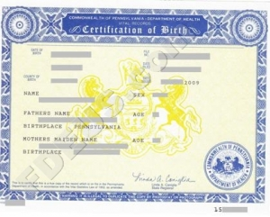
Legal Documents
A birth certificate
  Parents fill out a form provided by the hospital or birthing center- temporary
  Several weeks later, the parents receive one copy of the birth certificate, the other is sent to a government office to be filed
Social security number
  Forms to fill out

Slide 16
Premature Babies
Premature Babies Topic Extension Project

Slide 17
Caring for Premature Babies
Between 5 and 6% of all babies are premature babies
  Born before 37 weeks of development and weighing less than 5 pounds, 8 ounces
Incubator
  Special enclosed crib, supplied with oxygen and controlled temperature/humidity
    Special monitors

Slide 18
Birth Defects
Birth Defects Topic Extension Project

